Slide 1
Persuasive Speech
Recycling at Home

Slide 2
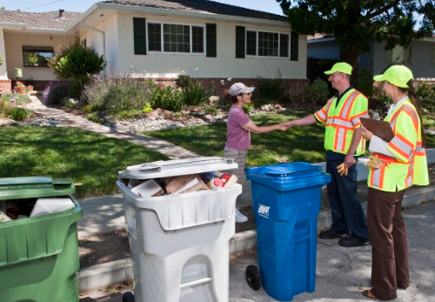
Introduction
Hello everyone, my presentation today is about recycling at home.
How many people drink some sort of bottled water in their homesteads on a daily bases?
How many of those people take the bottle in the trash once they are done?
Garbage has affected the environment variedly (Lindner, Braungart, & Essig, 2019).
It has come to my attention that recycling is the right thing to do even when we have plenty of resources.

Slide 3
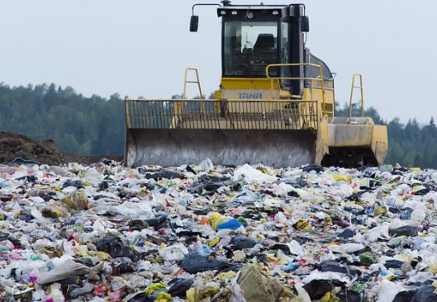
Effects of domestic waste products
Domestic waste product leads to the main forms of environmental pollution. These include
  Water pollution
  Air pollution
  Soil pollution
Notes:
I believe that every one of us here has ever come across a waste product while at home. Domestic waste product leads to the main forms of environmental pollution. These include water pollution, which occurs when domestic waste products enter into water bodies. Domestic waste products also cause air pollution, which takes place when the burn domestically acquired the waste product (Lindner et al., 2019). Soil pollution occurs when domestically acquired waste products mix with soils causing it unsafe for plants and animals. We should acknowledge the fact that domestic waste products are the closest enemies to our environmental wellness.

Slide 4
Major domestic waste products
Domestic waste products are found in every homestead (McDonald & Oke, 2018). However, their presence is felt depending on the adopted type of disposal.
The major types of domestic waste products include:
  Plastics.
  Papers.
  Aluminum.
Notes:
Domestic waste products are found in every homestead. However, their presence is felt depending on the adopted type of disposal. The major types of waste products include; plastics which are non-biodegradable products, and they end up affecting soil fertility, causing water pollution and even causing air pollution when burnt (McDonald & Oke, 2018). It is also worth to understand that burning unwanted papers and books in our homes increase greenhouse gas emission and hence increasing global warming. Other materials which cause greenhouse gas emission violate the conduciveness of the domestic environment. Instead, we should consider recycling these finished products to sustain the wellness of our environment.

Slide 5
Importance of Recycling at Home
The chief benefits of recycling include:
An easy process of reducing waste of energy.
Recycling reduces the need for clearance.
Recycling helps to restore the environment by reducing greenhouse gas emissions.
Recycling is important for children (Cheng, 2018).
Recycling helps in improving the quality of health and welfare.
Notes:
It is my pleasure to inform you that everyone is held accountable for the effects of his deeds in regards to the attached effects. Recycling should be the most appropriate approach that we should embrace in our homesteads to preserve our environments for present and future generations.
Recycling at home is essential since it serves as an easy process of reducing waste of energy since recycling products demands considerably less energy. Recycling reduces the need for clearance since recycling at home reduces the pile of resources that one might have no more need of (Cheng, 2018). Also, recycling at home would help to restore the environment by reducing greenhouse gas emissions. Recycling is important for children since it helps children to grow up responsible for nature and the environment.

Slide 6
Opposing views against recycling at home
Recycling at home has been faced with determined opposition based on the assertions that;
Recycling sites are always unhygienic (Cheng, 2018).
Products from recycled domestic waste are not durable.
Recycling might be costly.
Notes:
On the other hand, recycling at home has been faced with determined opposition based on the assertions that; recycling sites are always unhygienic, and they serve as the breeding zone for serious disease outbreaks (Cheng, 2018). Products from recycled domestic waste are not durable since they rely on low-quality raw materials. Recycling might be costly and procedural.

Slide 7

Stance
Recycling at home does much benefit than risks
It helps in restoring environmental wellness.
It improves health and welfare (Cheng, 2018).
We should abide by the need for recycling at home.
Notes:
It is worth to note that recycling at home does much benefit than risks. It helps in restoring environmental wellness (Cheng, 2018). It improves health and welfare, and hence we should abide by the need for recycling at home.

Slide 8
Conclusion
In summation, domestic waste products are the leading causes of environmental pollutions.
They lead to air pollution, water pollution, and soil pollution, as well (Cheng, 2018).
The major domestic environment pollutants include plastics and papers, among others.
Recycling at home stands a chance to make our domestic environments cleaner and very efficient in the future.
It is now the right time for every individual to subscribe to the benefits of recycling at home.
The earth is our home now and for many years to come.
Notes:
I am fully convinced that domestic waste products are the leading causes of environmental pollutions. They lead to air pollution, water pollution, and soil pollution as well. The major domestic environment pollutants include plastics and papers, among others. Recycling at home stands a chance to make our domestic environments cleaner and very efficient in the future (Cheng, 2018). It is now the right time for every individual to subscribe to the benefits of recycling at home. The earth is our home now and for many years to come.

Slide 9
References
Cheng, Y. (2018). “The Bag Is My Home”: Recycling “China Bags” in Contemporary African Art. african arts, 51(02), 18-31.
Lindner, S., Braungart, M., & Essig, N. (2019). Comparison of eco-effectiveness and eco-efficiency based criteria for the construction of single-family homes. In IOP Conference Series: Earth and Environmental Science (Vol. 225, No. 1, p. 012041). IOP Publishing.
McDonald, S., & Oke, A. (2018). Recycling at home and work: An exploratory comparison. Social Business, 8(2), 145-165.

